Slide 1


Slide 2





1
5
OOP
3
2
4

Slide 3
class
Objects / instances
member variables
OOP
Constructor
methods

Slide 4
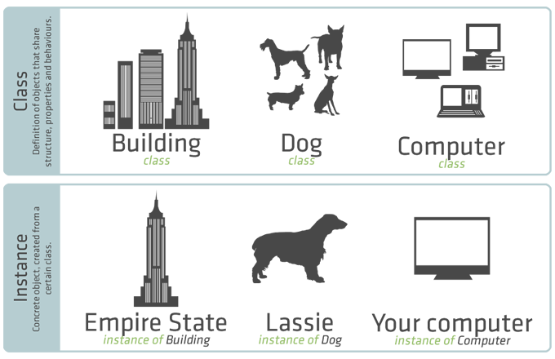

Slide 5




1
2
3
4

Slide 6
Abstraction
Inheritance
Polymorphism
Encapsulation

Slide 7
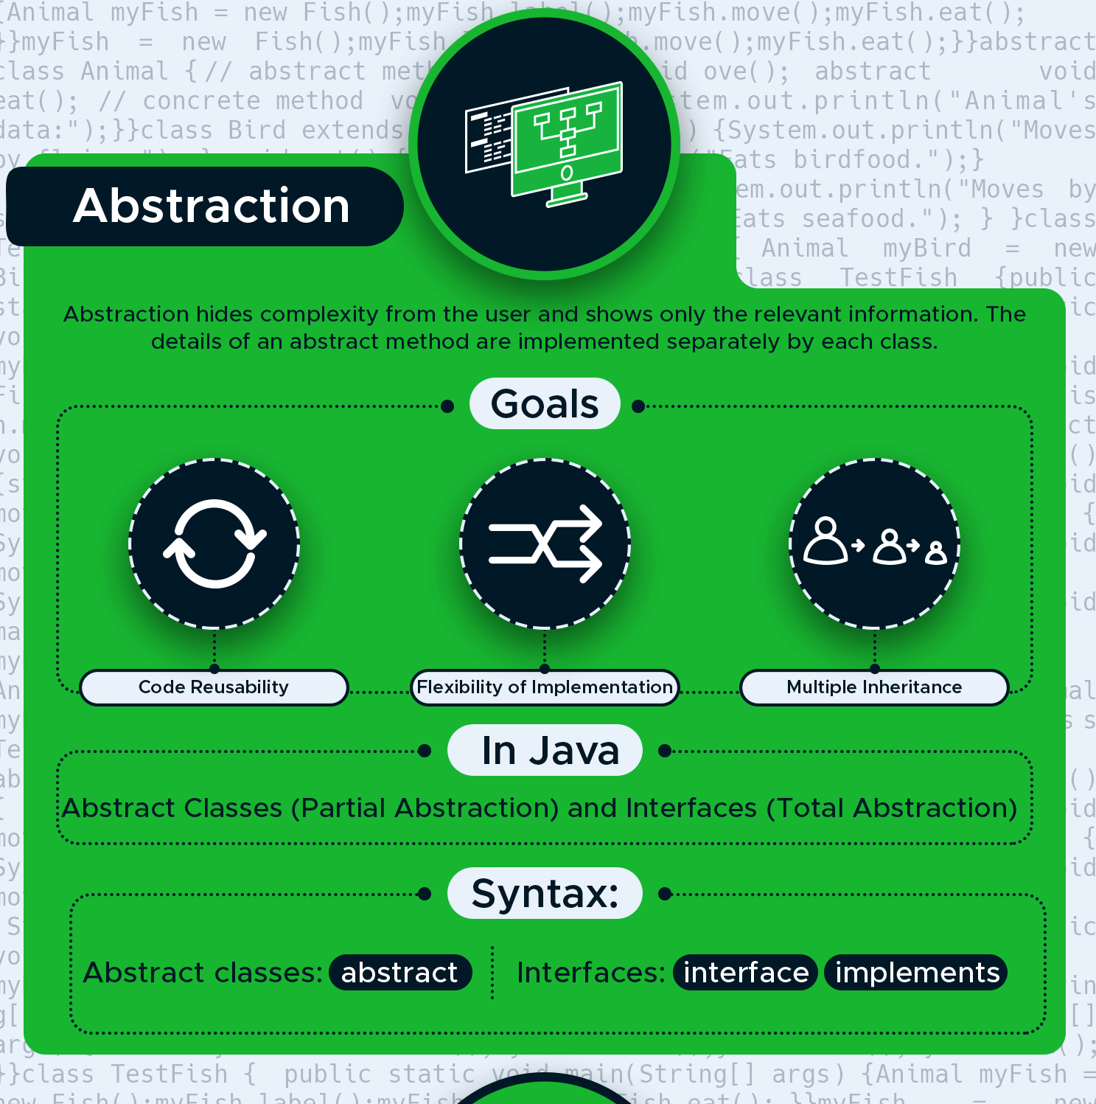

Slide 8
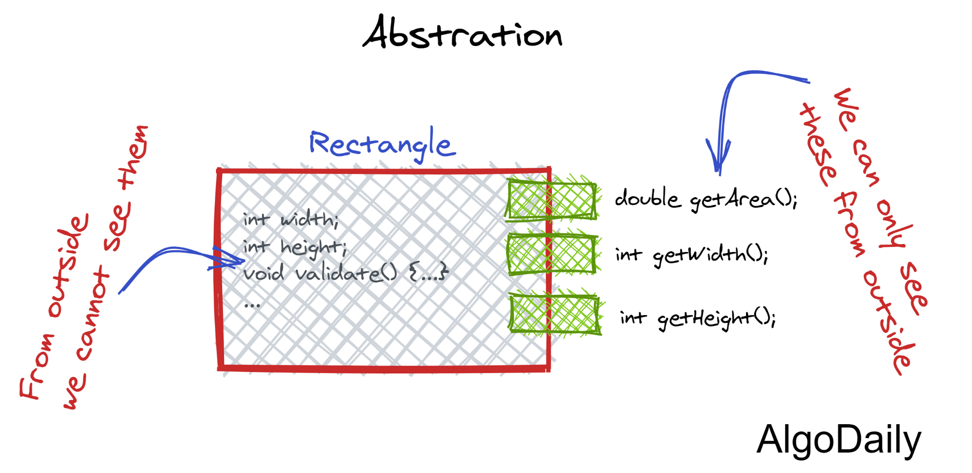
Abstraction

Slide 9
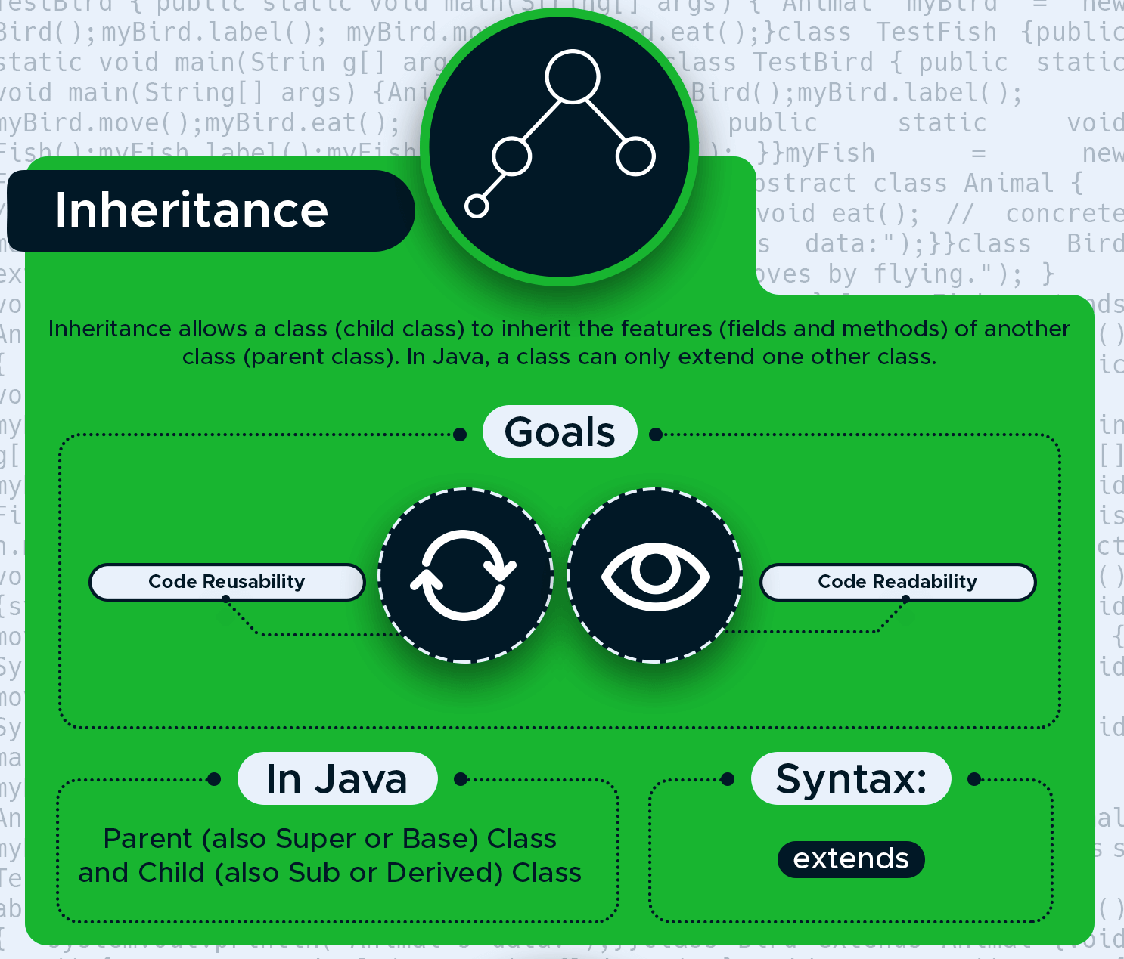

Slide 10
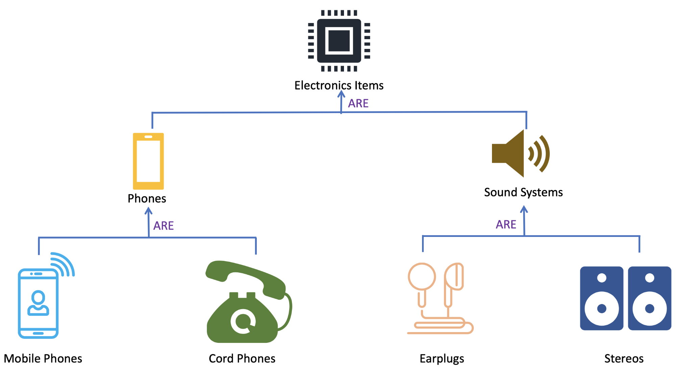

Slide 11
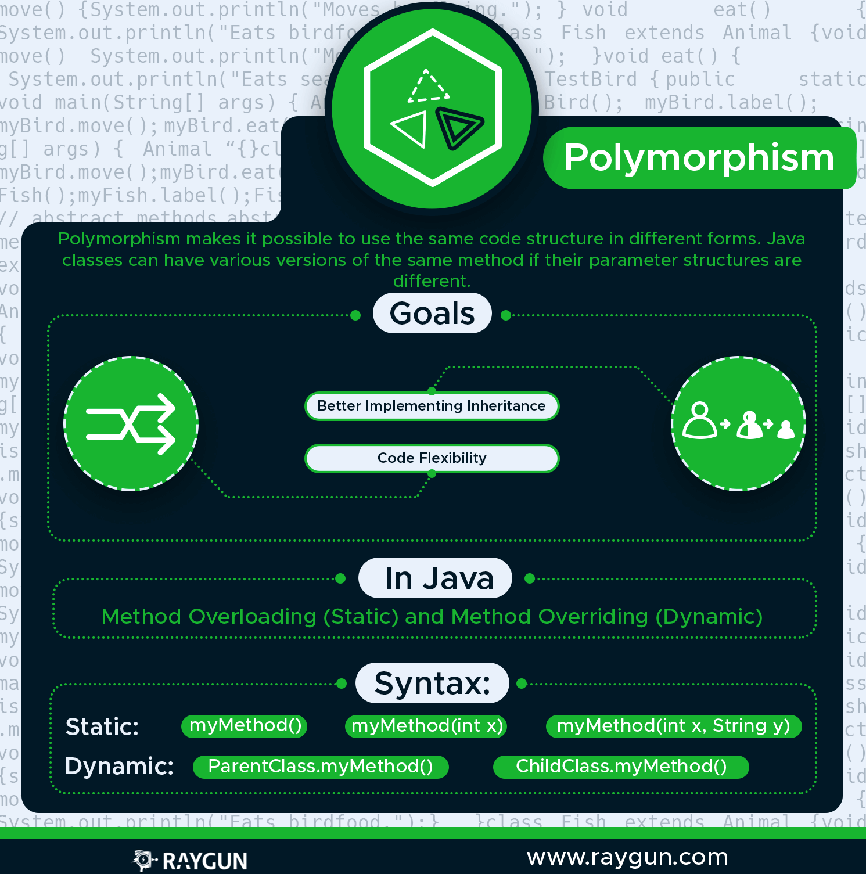

Slide 12
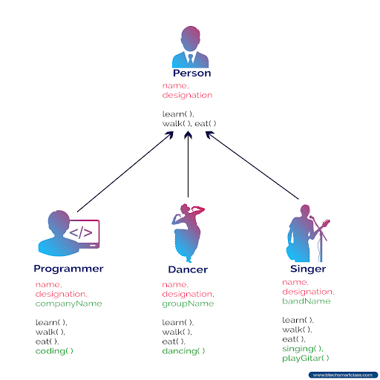

Slide 13
